Slide 1

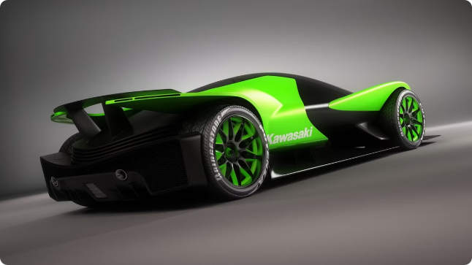


KAWASAKI's Ecommerce Venture
KAWASAKI, the renowned Japanese automobile manufacturer, has made a strategic foray into the world of ecommerce, offering its customers a seamless online shopping experience. This presentation will delve into the history, key features, and future plans of KAWASAKI's ecommerce platform, showcasing its commitment to innovation and customer satisfaction.
by Frankenstein The monster

Slide 2


History of KAWASAKI's Ecommerce Venture
KAWASAKI's ecommerce journey began in the early 2010s, as the company recognized the growing importance of online sales channels in the automotive industry. With a focus on convenience and accessibility, KAWASAKI invested heavily in developing a robust, user-friendly ecommerce platform to complement its traditional brick-and-mortar dealerships.

Slide 3

Reasons for Entering the Ecommerce Space
1
Expanding Reach
2
Improved Efficiency
KAWASAKI's ecommerce platform allows the company to reach a wider customer base, including those in remote or underserved areas, and provide them with the same high-quality products and services.
The ecommerce platform streamlines the sales process, reduces overhead costs, and enables KAWASAKI to respond to customer inquiries and orders more quickly and effectively.
3
Enhanced Customer Experience
KAWASAKI's ecommerce platform offers a personalized, convenient, and seamless shopping experience, allowing customers to browse, customize, and purchase vehicles from the comfort of their homes.

Slide 4
Key Features and Facilities of KAWASAKI's Ecommerce Platform
Comprehensive Product Catalog
Secure Payment Options
Virtual Test Drives
Customers can securely complete their purchases through a variety of payment methods, including credit/debit cards, digital wallets, and financing options.
The platform offers interactive virtual test drives, allowing customers to experience the performance and features of KAWASAKI vehicles before making a purchase.
KAWASAKI's ecommerce platform features an extensive catalog of its entire vehicle lineup, including detailed specifications, images, and customization options.

Slide 5

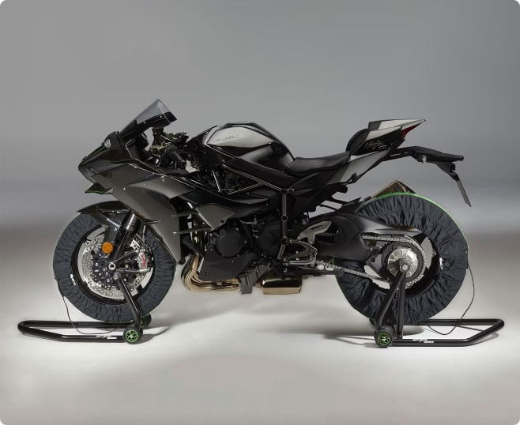
Ecommerce Sales and Customer Experience
1
Online Ordering
Customers can seamlessly order their desired KAWASAKI vehicle directly through the ecommerce platform, with options for customization and accessories.
2
Delivery and Installation
KAWASAKI's ecommerce platform provides convenient delivery and installation services, ensuring a hassle-free experience for customers.
3
After-Sales Support
The platform also offers comprehensive after-sales support, including warranty information, maintenance schedules, and access to KAWASAKI's network of authorized service centers.

Slide 6


Challenges Faced in Ecommerce Operations
Building Trust
Logistics and Fulfillment
Establishing customer trust in an online platform for a high-value purchase like a vehicle can be a significant challenge.
Ensuring timely and efficient delivery of vehicles ordered through the ecommerce platform requires careful logistics planning and coordination.
Integrating Online and Offline
Data Security
Seamlessly integrating the ecommerce platform with KAWASAKI's existing dealership network and physical sales channels is crucial for a cohesive customer experience.
Protecting customers' sensitive personal and financial information is a top priority for KAWASAKI's ecommerce operations.

Slide 7
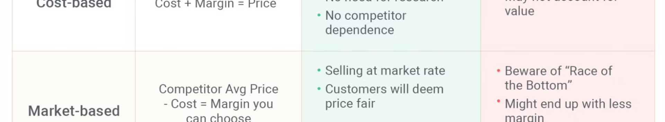




Strategies to Overcome Ecommerce Obstacles
Build Trust
Streamline Logistics
Seamless Integration
Prioritize Data Security
KAWASAKI focuses on transparency, clear communication, and a user-friendly platform to instill confidence in its online customers.
The company has invested in robust supply chain management and delivery systems to ensure timely and efficient vehicle fulfillment.
KAWASAKI has worked to closely align its online and offline sales channels, providing a seamless customer experience.
KAWASAKI implements strict data privacy and security protocols to protect its customers' personal and financial information.

Slide 8


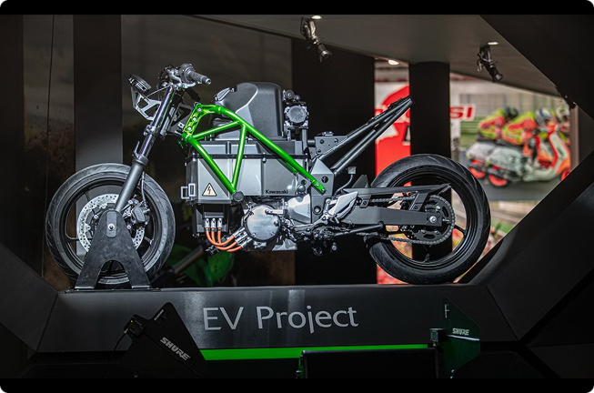


Importance of Ecommerce for KAWASAKI's Business
Expanded Reach
KAWASAKI's ecommerce platform allows the company to connect with a broader customer base, including those in remote or underserved areas.
Increased Efficiency
The platform streamlines the sales process, reducing overhead costs and enabling faster response times to customer inquiries and orders.
Enhanced Customer Satisfaction
By providing a seamless and personalized online shopping experience, KAWASAKI has been able to improve customer satisfaction and loyalty.

Slide 9

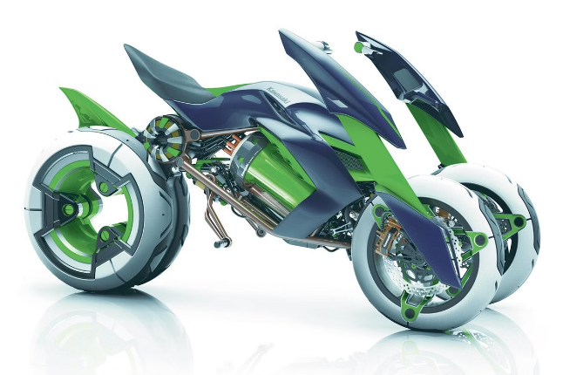
Future Plans and Expansion of Ecommerce
Enhance Virtual Experiences
Expand to New Markets
Integrate Emerging Technologies
KAWASAKI plans to further develop its virtual test drive and customization capabilities to provide an even more immersive online experience.
The company aims to leverage its ecommerce platform to reach customers in new geographic markets, both domestically and internationally.
KAWASAKI will explore integrating emerging technologies such as augmented reality and artificial intelligence to streamline the online buying process.

Slide 10

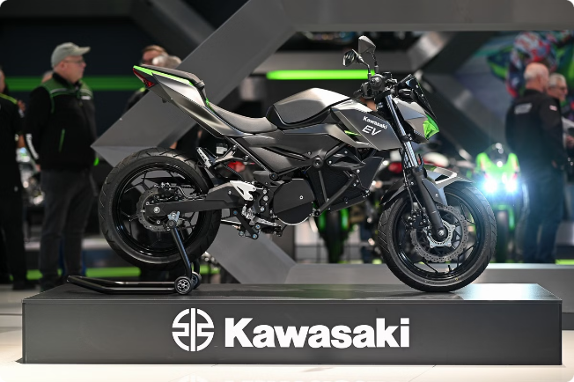
Conclusion and Key Takeaways
1
Embracing Digital Transformation
2
Enhancing Customer Experience
KAWASAKI's ecommerce venture demonstrates the company's commitment to embracing digital transformation and meeting the evolving needs of its customers.
By investing in its ecommerce platform, KAWASAKI has been able to provide a seamless, personalized, and convenient shopping experience for its customers.
3
Overcoming Ecommerce Challenges
KAWASAKI has proactively addressed the challenges of building trust, streamlining logistics, and ensuring data security to deliver a successful ecommerce offering.

